Slide 1

WiFi: The Technology That Connects the World
Presented by
Name: Swapnil Saha
IT-21028
Course Title: Wireless Communication

Slide 2

Introduction to WiFi
Understanding Wireless Network Technology
WiFi is a revolutionary technology that uses radio waves to provide internet access wirelessly. It connects multiple devices, allowing seamless communication without the need for physical cables.
2

Slide 3
History of WiFi
Continuous Upgrades
IEEE 802.11
First Products
WiFi Alliance
IEEE 802.11 standard was established in 1997.
The first WiFi products were released in 1999.
The WiFi Alliance was formed to promote interoperability.
WiFi has undergone continuous upgrades and improvements.
3

Slide 4
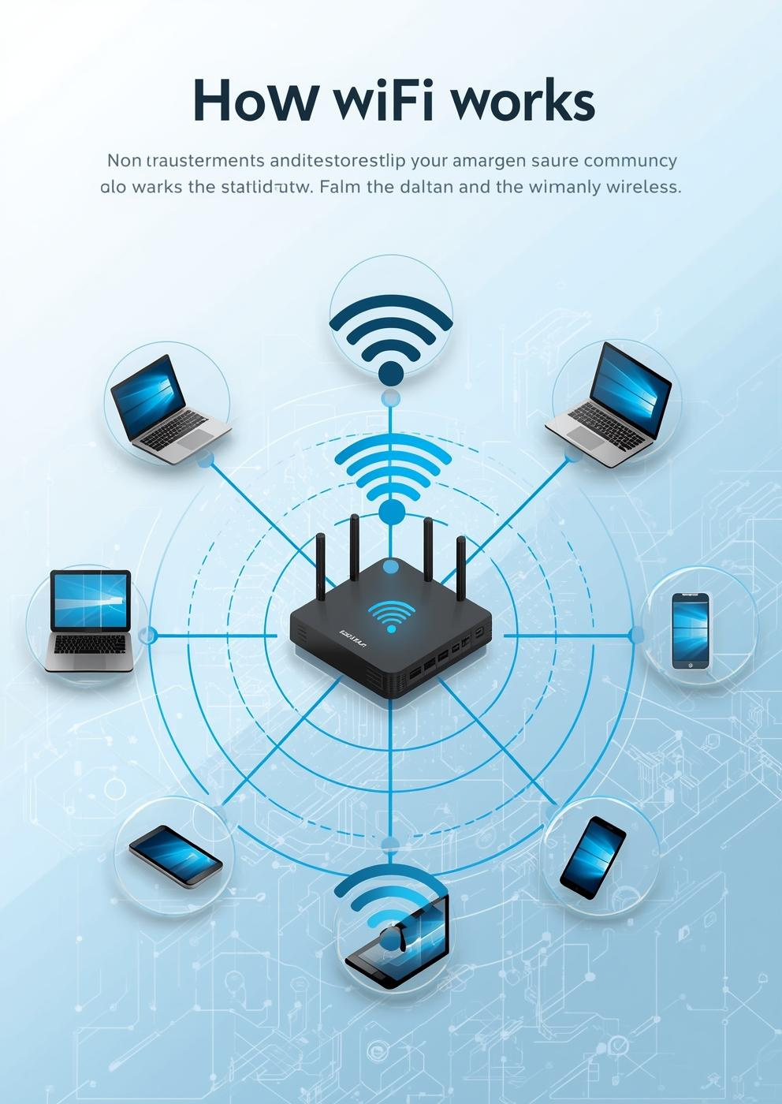
How WiFi Functions
Understanding the Transmission Process
Data travels as radio waves
Router converts wired signals
Devices decode the signals
Communication occurs via IP
4

Slide 5
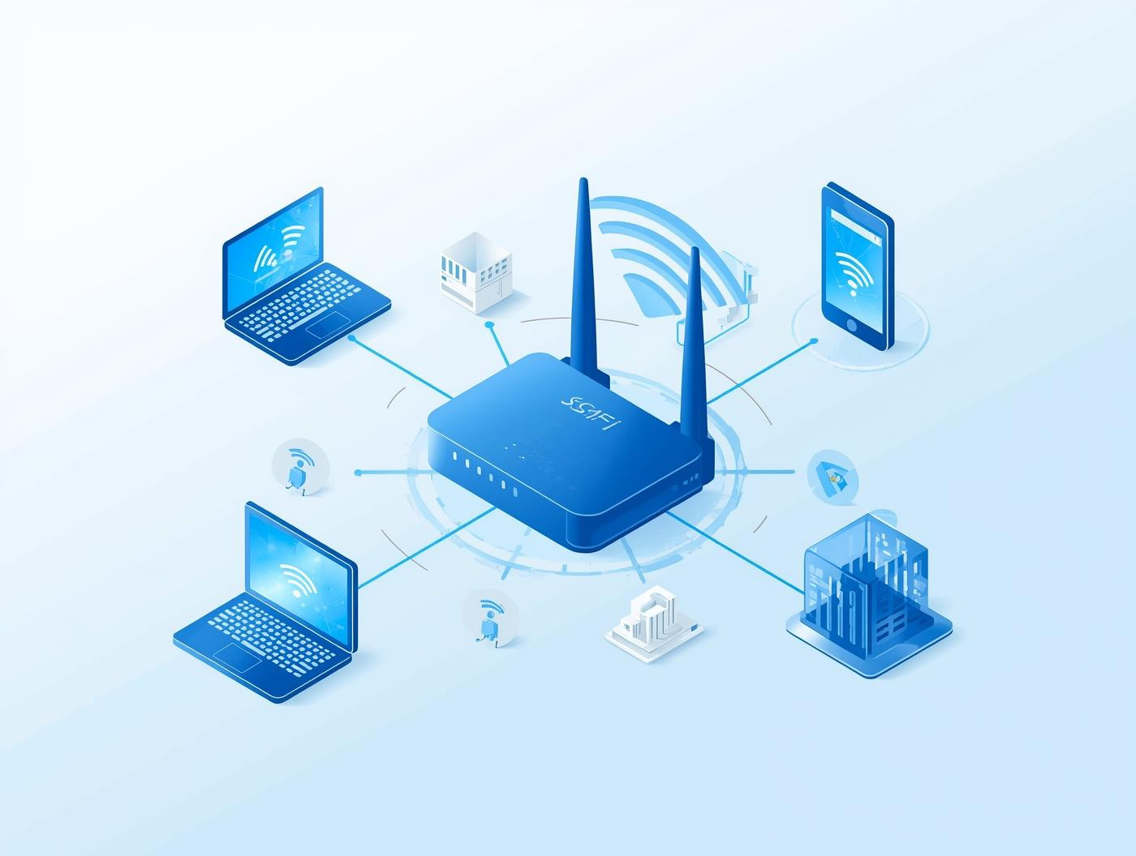
Understanding WiFi Architecture Components
Architecture
Components enable seamless connectivity across devices and networks.
5

Slide 6

WiFi Standards Overview
802.11b
802.11g
Introduced in 1999, it offered speeds up to 11 Mbps.
Released in 2003, it improved speeds to 54 Mbps.
802.11n
802.11ac
Launched in 2009, it enhanced speeds up to 600 Mbps.
Introduced in 2013, it achieved gigabit speeds, enhancing connectivity.
6

Slide 7
Frequencies and Channels
2.4GHz
5GHz
6GHz Band
The 2.4GHz band offers wider coverage and compatibility.
The 5GHz band provides faster speeds and less interference.
The new 6GHz band supports greater capacity and performance.
Channel Overlap
Signal Interference
Overlapping channels can cause interference and reduce performance.
Interference from devices can impact signal quality and connectivity.
7

Slide 8
Network Topologies
Infrastructure
Ad-hoc
Infrastructure mode uses centralized control via access points.
Ad-hoc mode allows peer-to-peer connections without routers.
Access Point
Peer-to-Peer
Access points manage device connections and network traffic efficiently.
Peer-to-peer setups enable direct communication between devices easily.
8

Slide 9
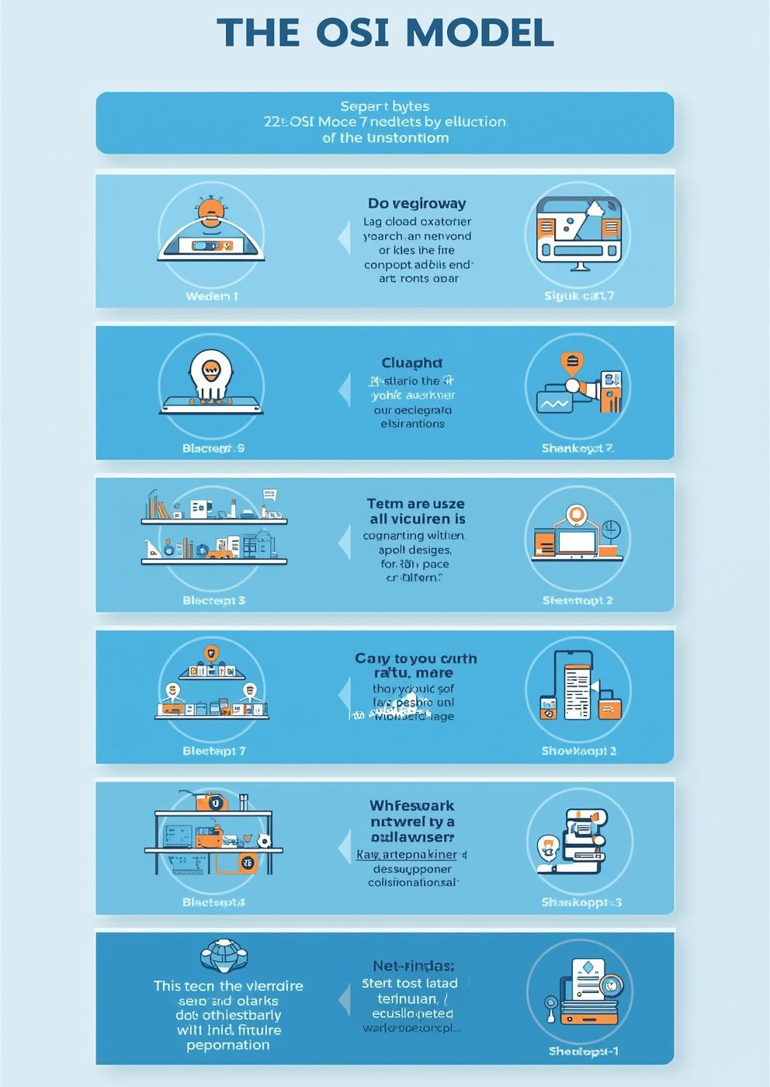
WiFi Protocol Stack
Understanding Data Transmission Layers
Physical layer handles signal transmission
MAC layer manages data link protocols
Packet framing ensures data integrity
Error checking maintains communication reliability
9

Slide 10
WiFi Security Mechanisms
WEP
WPA
Wired Equivalent Privacy offers basic protection for networks.
WiFi Protected Access improves security with better encryption standards.
WPA2
WPA3
WiFi Protected Access 2 enhances security with stronger encryption methods.
WiFi Protected Access 3 provides advanced defenses against unauthorized access.
10

Slide 11

WiFi Authentication & Encryption
Securing Wireless Connections Effectively
Passwords protect network access
Handshake establishes secure link
AES is an encryption standard
Verification ensures data integrity
11

Slide 12
Advantages of WiFi
Mobility
Convenience
Scalability
Wireless connectivity allows users to move freely anywhere.
Multiple devices connect to the internet without cables.
Easily expand connectivity to more devices as needed.
Easy Installation
Cost-Effective
Setting up a WiFi network typically requires minimal effort.
WiFi reduces the need for expensive wired infrastructure investments.
12

Slide 13
Limitations of WiFi
Limited Range
Interference
WiFi signals diminish strength over long distances from the router.
Physical obstacles and devices can disrupt WiFi signal quality significantly.
Security Vulnerabilities
Speed Drops
Open networks can expose sensitive data to potential cyber threats.
Connection speeds decrease as devices move farther from the source.
13

Slide 14
Comparing WiFi and Mobile
Cost
Coverage
Speed
WiFi is generally cheaper for local internet use.
5G networks offer wider coverage across large areas.
WiFi often provides faster speeds in local connections.
Latency
Accessibility
Flexibility
Mobile networks typically have higher latency than WiFi.
WiFi is commonly accessible in homes and cafes.
5G provides flexibility for mobile users on the go.
14

Slide 15
WiFi Applications
Homes
Offices
Education
WiFi connects various devices, enhancing convenience for families.
Businesses utilize WiFi to foster collaboration and communication.
Schools leverage WiFi for online learning and research access.
Public Hotspots
IoT
WiFi enables connectivity in cafes, libraries, and airports.
WiFi supports smart devices, facilitating seamless automation and data exchange.
15

Slide 16

WiFi's Role in the Internet of Things
Connectivity
WiFi enables seamless real-time data exchange between devices.
16

Slide 17
Recent Innovations
WiFi 6E
WiFi 7
WiFi 6E offers expanded channels in the 6GHz band.
WiFi 7 provides even faster speeds and improved performance.
Higher Bandwidth
AI Optimization
Innovations lead to increased bandwidth, supporting more devices.
AI integration enhances network management and performance efficiency.
17

Slide 18
Troubleshooting WiFi Issues
Restart Router
Change Channel
Simply powering off and on can resolve many issues.
Switching channels reduces signal interference from neighboring devices.
Firmware Update
Reduce Interference
Keeping router firmware updated ensures optimal performance and security.
Minimizing obstacles can enhance WiFi signal strength and reliability.
18

Slide 19
Future of WiFi
6GHz Adoption
WiFi Sensing
The 6GHz band offers enhanced speed and reduced congestion.
WiFi sensing technology enables new applications in smart environments.
19

Slide 20
Thank You
For your
Attention

